Slide 1

CITY ASSESSOR’S OFFICE Brian E. Gordineer, AAS – City Assessor Br
City Assessor’s Report October 15, 2019

Slide 2
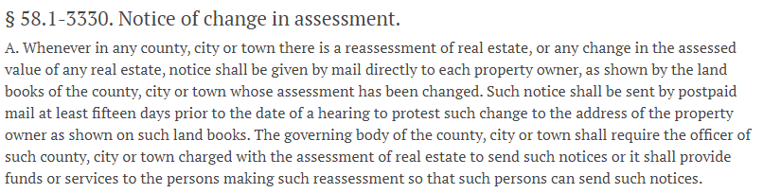
CITY ASSESSOR’S OFFICE Brian E. Gordineer, AAS – City Assessor Br
NOTICE OF CHANGE IN ASSESSMENT

Slide 3
CITY ASSESSOR’S OFFICE Brian E. Gordineer, AAS – City Assessor Br
New Construction / Additions / Demolitions
Splits / Combinations / Acreage Changes
Rezonings / Special Use Permits
Biennial Reasessment

Slide 4
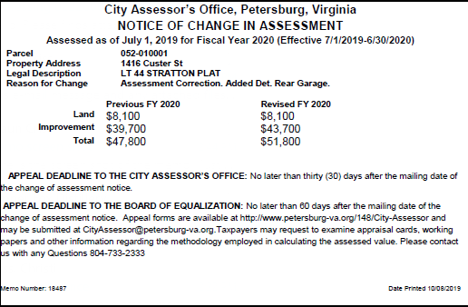
CITY ASSESSOR’S OFFICE Brian E. Gordineer, AAS – City Assessor Br

