Slide 1

CITY ASSESSOR’S OFFICE
Brian E. Gordineer, AAS – City Assessor
Br
City Assessor’s Report
December 10, 2019

Slide 2
CITY ASSESSOR’S OFFICE
Brian E. Gordineer, AAS – City Assessor
Br
REASSESSMENT CALENDAR
Reassessment Change Notices Jan. 28
Office Review Appeal Deadline Mar. 1
Board of Equalization Appeal Deadline Apr. 1
Board of Equalization Hearings Jun. 30

Slide 3
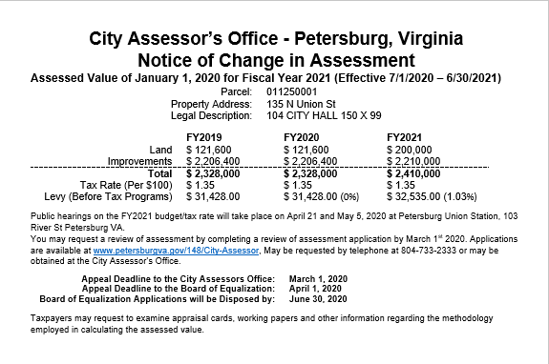
CITY ASSESSOR’S OFFICE
Brian E. Gordineer, AAS – City Assessor
Br
Jan. 28

Slide 4
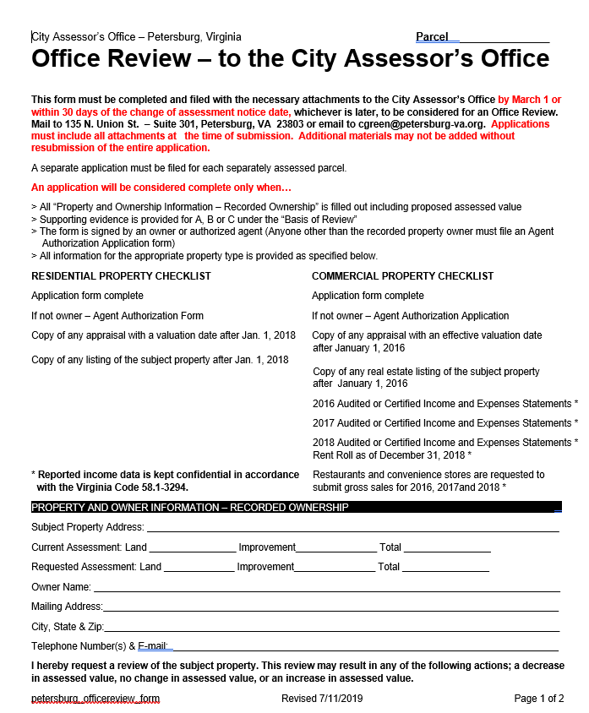
CITY ASSESSOR’S OFFICE
Brian E. Gordineer, AAS – City Assessor
Br
Mar. 1

Slide 5
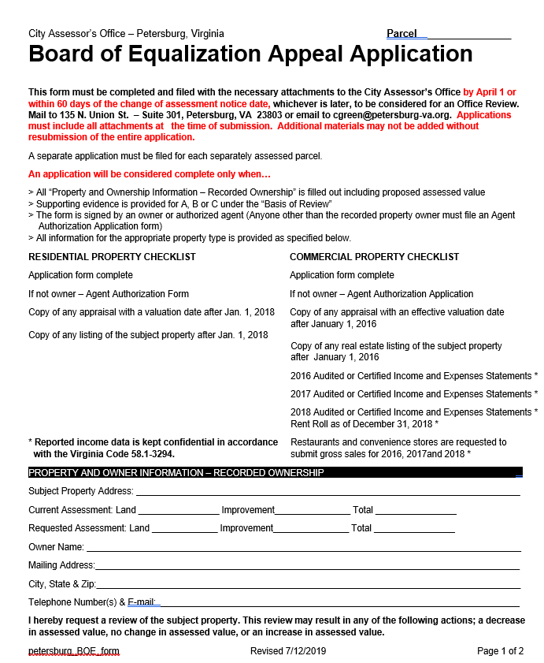
CITY ASSESSOR’S OFFICE
Brian E. Gordineer, AAS – City Assessor
Br
Apr. 1

Slide 6
CITY ASSESSOR’S OFFICE
Brian E. Gordineer, AAS – City Assessor
Br
Board of Equalization
Hearings
May and June

